Slide 1

Male and Female Reproductive Anatomy

Slide 2
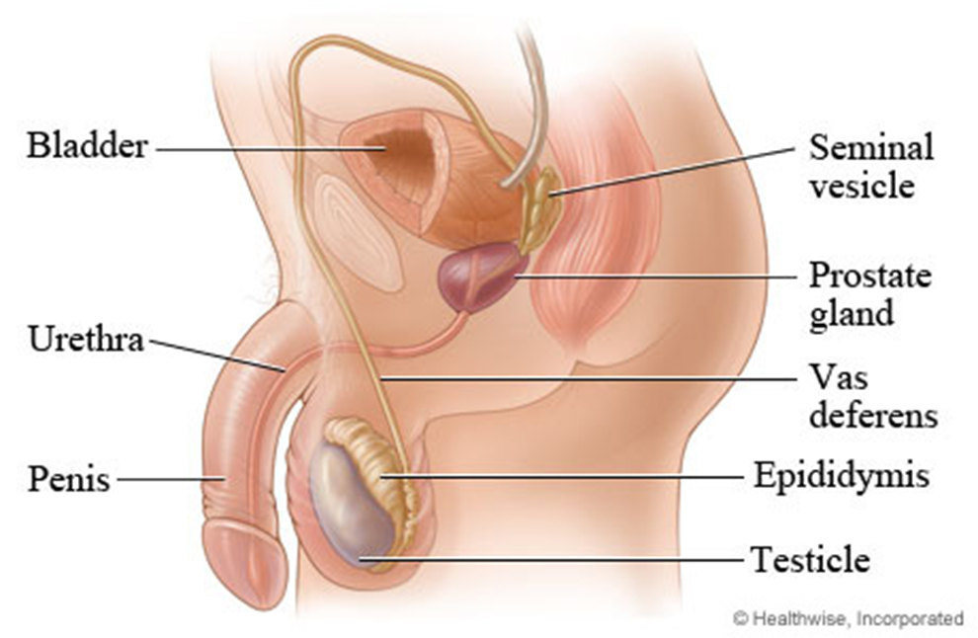
Male Reproductive System
& Functions
– Penis-male sex organ
– Foreskin-protects
– Scrotum-sac that holds the testes, controls temperature
– Testicle-produce sperm cells
– Epididymis-structure on upper surface of each testicle, stores sperm
– Vas Deferens-tube sperm travels through
– Seminal Vesicle-2 small glands, secrete sugary fluid that provides energy for sperm
– Prostate-alkaline fluid, helps sperm live long by nourishing and protecting it
– Bulbo-urethral gland (Cowper's gland) 2 glands on side of urethra, secretes lubricating fluid
-Semen-
– Urethra-tube serves as passageway for semen and urine
Bulbo-urethral gland

Slide 3
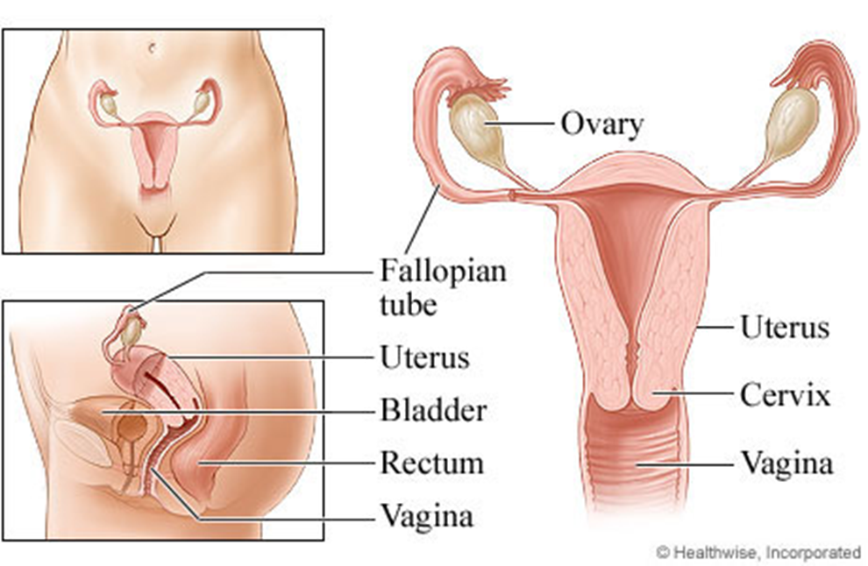
Female Reproductive System
& Functions
– Ovaries-produces egg cell, size of diamond, produce female hormone
-ovulation-releasing mature egg down fallopian tube, available to be fertilized
– Fallopian Tube-egg gets fertilized by sperm
– Uterus-womb, strong, hollow muscle, safe, nourishing cavity for embryo that grows into a baby
-menstruation-NOT fertilized, egg released with the lining of the uterus monthly OR fertilized, wall thickens to protect embryo, fetus, baby
– Cervix-lower portion of the uterus, must dilate -open to allow baby out
– Vagina-passageway to outside of body

Slide 4

https://www.youtube.com/watch?v=QGQ_5nD8Q-Q

Slide 5
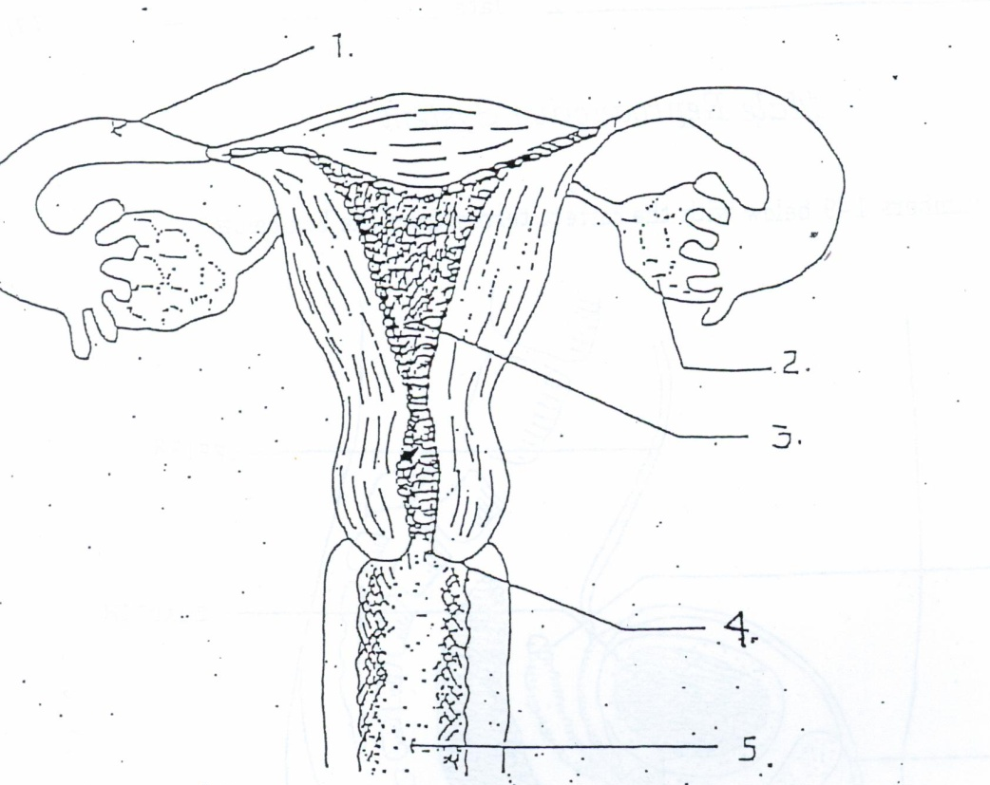
Female Reproductive System
#1 – Fallopian Tube-egg gets fertilized by sperm
#2 – Ovaries-produces egg cell, size of diamond, produce female hormone
#3 – Uterus-womb, strong, hollow muscle, safe, nourishing cavity for embryo that grows into a baby
#4 – Cervix-lower portion of the uterus, must dilate—open to allow baby out
#5 – Vagina-passageway to outside of body

Slide 6
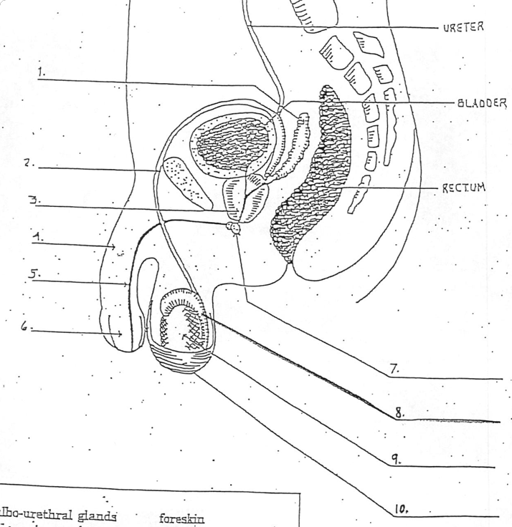
Male Reproductive System
#1 – Seminal Vesicle-2 small glands, secrete sugary fluid that provides energy for sperm
#2 – Vas Deferens-tube sperm travels through
#3 – Prostate-acidic fluid, helps sperm live long by nourishing and protecting it
#4 – Penis-male sex organ
#5 – Urethra-tube serves as passageway for semen and urine
#6 – Foreskin-protects
#7 – Bulbo-urethral gland (cowper’s gland) 2 glands on side of urethra, secretes lubricating fluid
#8 – Epididymis-structure on upper surface of each testicle, stores sperm
#9 – Testicle-produce sperm cells
#10 – Scrotum-sac that holds the testes, controls temperature

